Slide 1
STEPPER MOTOR MODULATION VALVE DIAGNOSIS

Slide 2
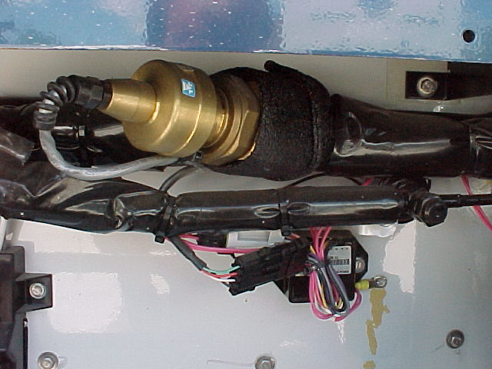
VALVE
DRIVER

Slide 3
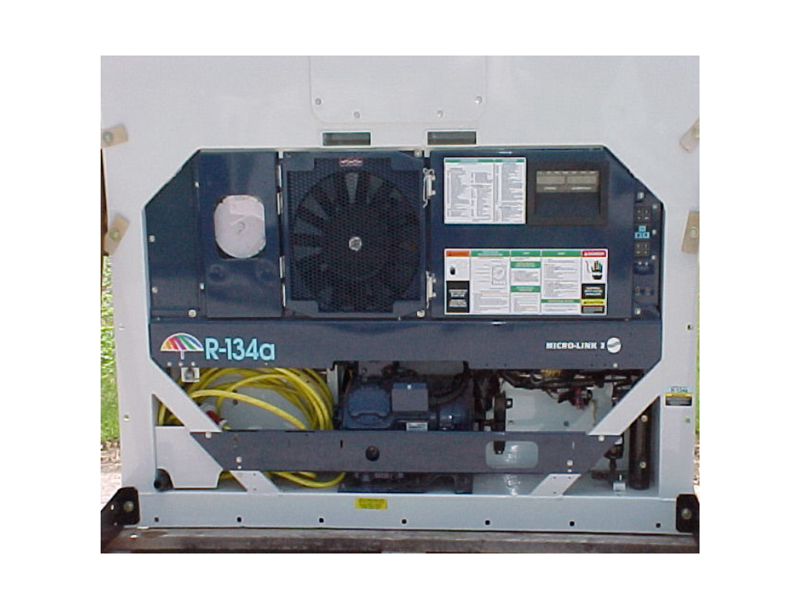



Slide 4
Check Resistance
value of Stepper Motor
Modulation Valve plug
pins: A-B and C-D
A
B
C
D

Slide 5
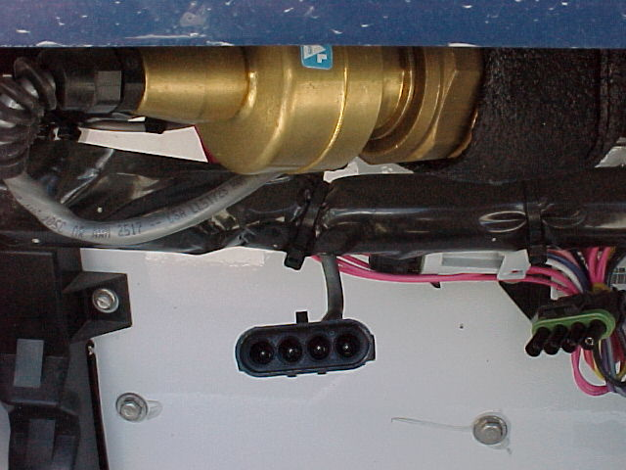
VALVE
DRIVER
C
B
A
D

Slide 6
Check Resistance
value of Stepper Motor
Modulation Valve plug
pins: A-B and C-D
A
B
C
D
A - B = 72 - 84 Ω
C - D = 72 - 84 Ω

Slide 7
D
C
B
A
During the first 40 seconds
after the self test
measure the AC voltage
at the Driver Module
out-put plug
pins: A-B and C-D
DRIVER
MODULE
A - B = 12 - 16 Vac
C - D = 12 - 16 Vac

Slide 8
VALVE
DRIVER
B
C
D
A

Slide 9
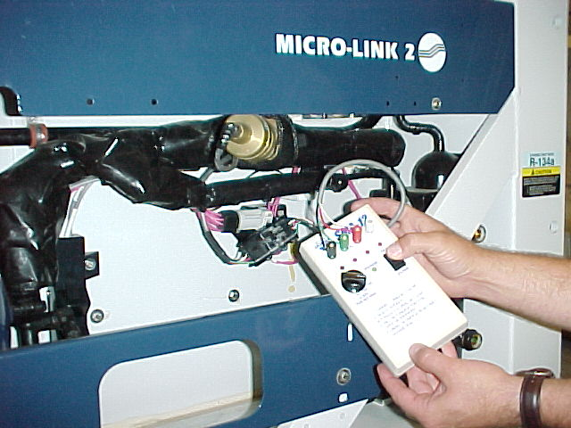
07-0035-00

